Slide 1
DBMS SQL-TCL

Slide 2
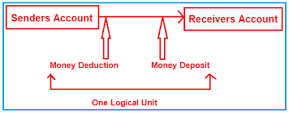

Slide 3
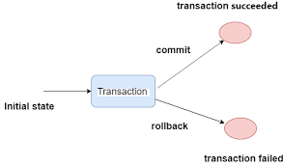

Slide 4
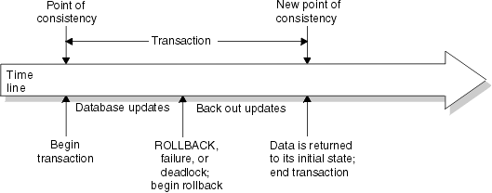

Slide 5
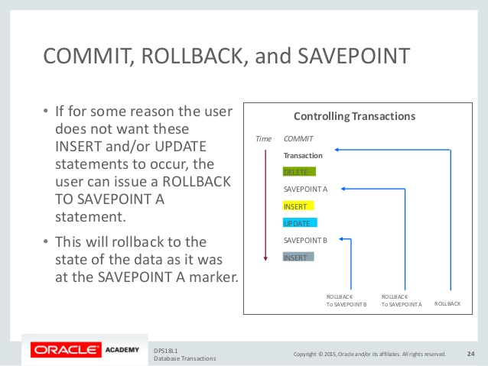

Slide 6
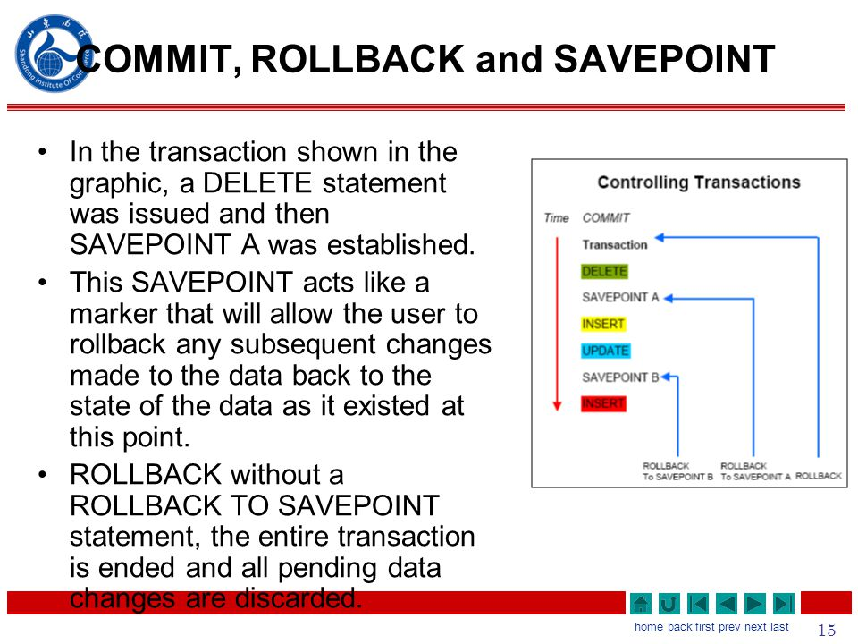

Slide 7


Slide 8
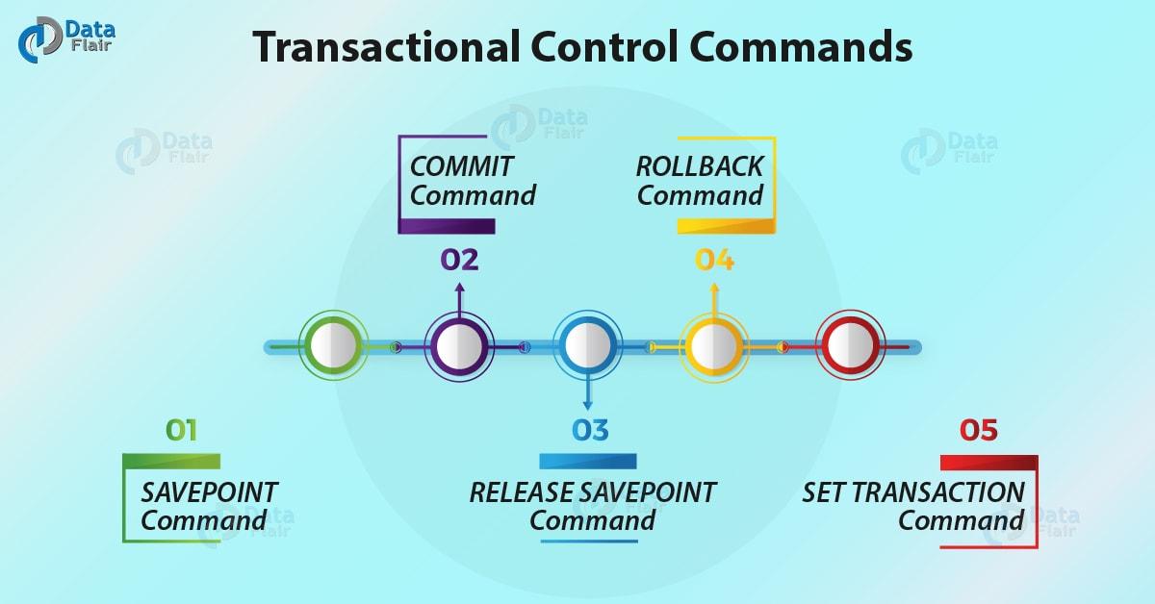

Slide 9
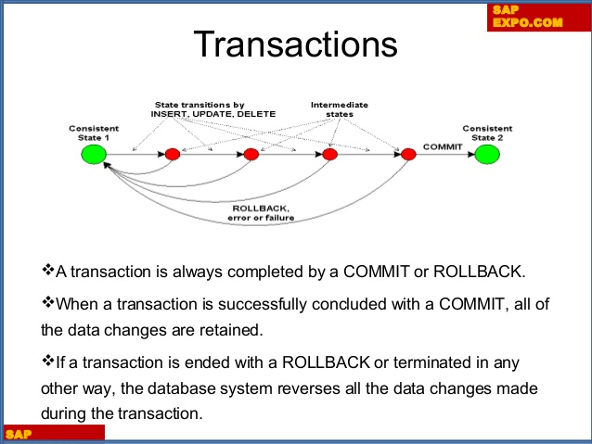

Slide 10
transaction Control Language
TCL commands deals with the transaction within the database.

Slide 11
COMMIT– commits a Transaction.
ROLLBACK– rollbacks a transaction in case of any error occurs.
SAVEPOINT–sets a savepoint within a transaction.
SET TRANSACTION–specify characteristics for the transaction.

Slide 12
Commit command
Commit command is used to permanently save any transaction into database.

Slide 13
Syntax:
commit;

Slide 14
Rollback command
This command restores the database to last commited state.
It is also use with savepoint command to jump to a savepoint in a transaction.

Slide 15
syntax
rollback to savepoint-name;

Slide 16
Savepoint command
savepoint command is used to temporarily save a transaction so that you can rollback to that point whenever necessary.

Slide 17
Syntax:
savepoint savepoint-name;

Slide 18
Example of Savepoint and Rollback
ID | NAME
1 | ankit
2 | anuj
4 | garima

Slide 19
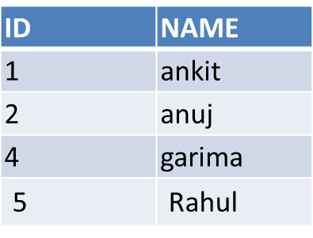
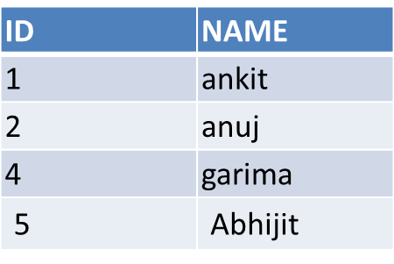

INSERT into class values(5,'Rahul');
commit;
UPDATE class set name='abhijit' where id='5';
savepoint A;

Slide 20
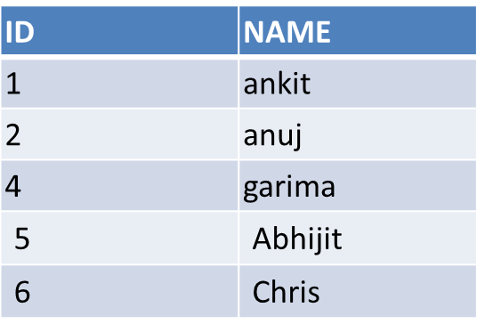
INSERT into class values(6,'Chris');
savepoint B;
INSERT into class values(7,'Bravo');
savepoint C;
SELECT * from class;

Slide 21
The resultant table will look like,
ID | NAME
1 | ankit
2 | anuj
4 | garima
5 | abhijit
6 | chris
7 | bravo
Savepoint C

Slide 22
Now rollback to savepoint B
rollback to B;
SELECT * from class;

Slide 23
The resultant table will look like
ID | NAME
1 | ankit
2 | anuj
4 | garima
5 | abhijit
6 | chris

Slide 24
Now rollback to savepoint A
rollback to A;
SELECT * from class;

Slide 25
The result table will look like
ID | NAME
1 | ankit
2 | anuj
4 | garima
5 | abhijit

Slide 26
One more example
Customer:-
CUSTOMER ID | CUSTOMER NAME | STATE | COUNTRY
1 | Akash | Delhi | India
2 | Amit | Hyderabad | India
3 | Jason | California | USA
4 | John | Texas | USA

Slide 27
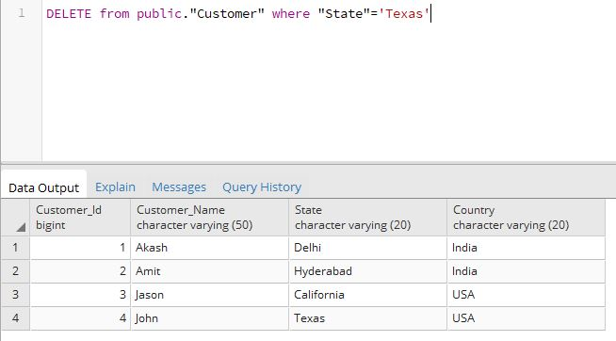
Now let us delete one row from the above table where State is “Texas”.
DELETE from Customer where State = 'Texas';

Slide 28
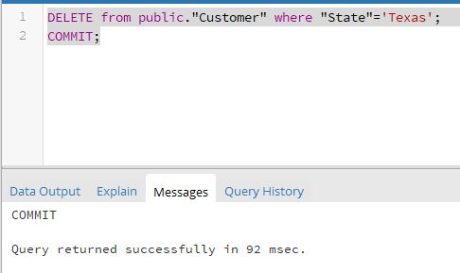
DELETE from Customer where State = 'Texas'; COMMIT;

Slide 29
Output After Commit
CUSTOMER ID | CUSTOMER NAME | STATE | COUNTRY
1 | Akash | Delhi | India
2 | Amit | Hyderabad | India
3 | Jason | California | USA

Slide 30
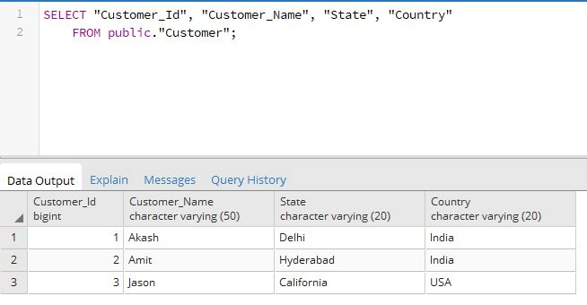

Slide 31
COMMIT | ROLLBACK
COMMIT permanently saves the changes made by current transaction. | ROLLBACK undo the changes made by current transaction.
Transaction can not undo changes after COMMIT execution. | Transaction reaches its previous state after ROLLBACK.
When transaction is successful, COMMIT is applied. | When transaction is aborted, ROLLBACK occurs.

Slide 32
Thank you !

Slide 33
Consider following employee database.
Employee(empname,street, city,date_of_joining)
Works(empname,company_name, salary)
Company(company_name,city)
Manages(empname,manager_name)

Slide 34
Write SQL queries for the following statements:
1. Modify the database so that John now lives in Mumbai.
2. Give all employees of ABC corporation a 10% raise.

